Slide 1


Dockerization Documentation

Slide 2
Deploying a Machine Learning Model with Docker: A Step-by-Step Guide
Step 1:We have to Prepare our ML Model
Ensure that we have our ML model trained and ready.
Step 2: Save our Trained Model
Save our trained model to a file using serialization libraries like pickle or joblib. This step is crucial for later deployment. (e.g., pickled models) ready for deployment.
Step 3: Save Preprocessing Objects
If we used any preprocessing steps during training, save those objects (e.g., vectorizers) to ensure consistency during deployment.
Step 4: Create a Prediction Script
Develop Prediction Function:
Create a simple script or function that loads the trained model and any necessary preprocessing objects. This script should be capable of making predictions based on new data.
Step 5: Dockerize Your Model
Create Docker file:
Develop a Docker file specifying the dependencies and commands needed to run your prediction script.
Build Docker Image:
Build a Docker image using the docker build command.
Run Docker Container:
Run a Docker container using the docker run command, making our prediction script accessible through an API.
Step 6: Test our Deployed Model:
Use sample data to test your deployed model. Ensure that the predictions are coming as expected.

Slide 3
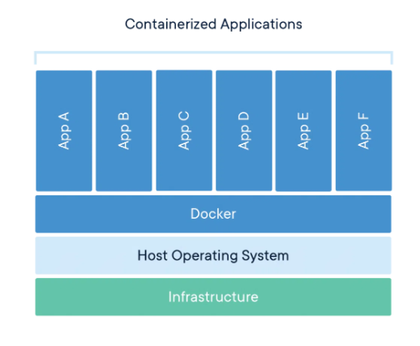
What is Docker?
Docker is a platform for building, running, and managing containerized applications.
Containers are lightweight, standalone, executable packages of software that include everything needed to run an application: code, runtime, system tools, system libraries and settings.
Docker makes it easy to package up an application and its dependencies into a single image that can be run consistently across different environments.

Slide 4
Why use Docker?
Portability: Docker containers can be run on any system that has the Docker Engine installed. This makes it easy to move applications between different environments, such as development, staging, and production.
Isolation: Docker containers are isolated from each other, which means that they cannot interfere with each other. This makes it easy to run multiple applications on the same system without worrying about conflicts.
Reproducibility: Docker containers are always built from the same image, which means that they are always reproducible. This makes it easy to deploy applications consistently across different environments.
Resource efficiency: Docker containers share the host machine's kernel, which means that they are more resource-efficient than traditional virtual machines.

Slide 5
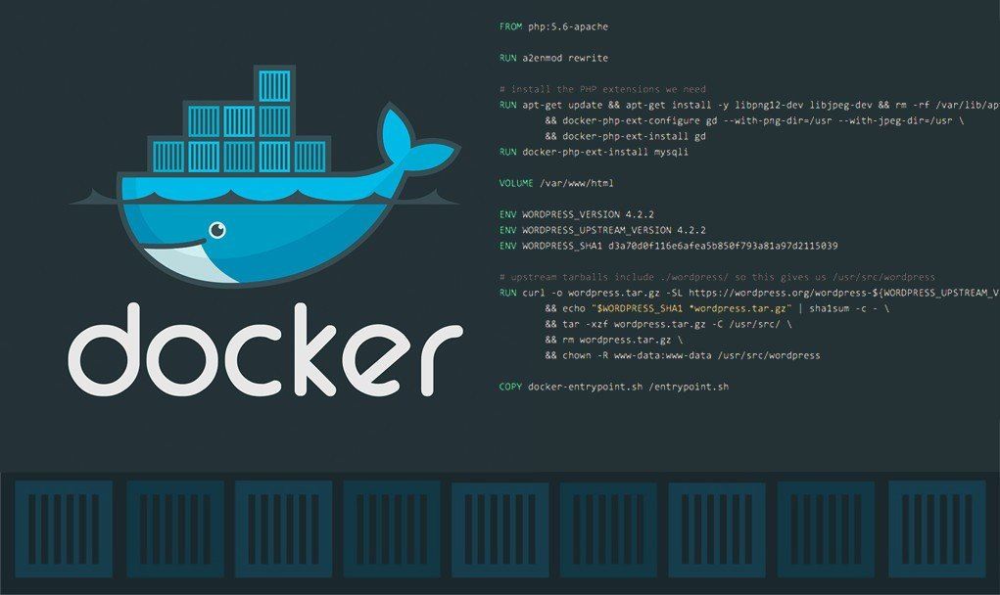
How does Docker work?
Docker images are built from Dockerfiles.
Dockerfiles are text files that contain instructions for building a Docker image.
Docker images are stored in a registry.
Docker registries are central repositories where Docker images can be stored and shared.
Docker containers are created from Docker images.
Docker containers are run on Docker hosts.
Docker hosts are machines that have the Docker Engine installed.

Slide 6
Why containers?
Container: A way to package application with all the necessary dependencies and configuration.
1) It is portable (easy to share and move)
2) Makes deployment more easy and efficient.

Slide 7
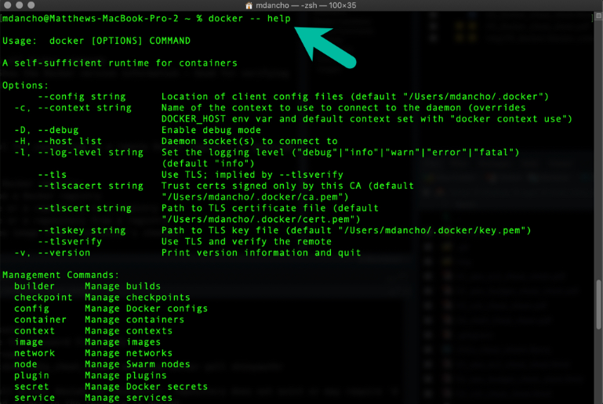
Docker commands

Slide 8
Docker commands
Docker build: Builds a Docker image from a Dockerfile.
Docker run: Runs a Docker container from an image.
Docker pull: Pulls a Docker image from a registry.
Docker push: Pushes a Docker image to a registry.
Docker ps: Lists all running Docker containers.
Docker stop: Stops a running Docker container.
Docker rm: Removes a stopped Docker container.

Slide 9
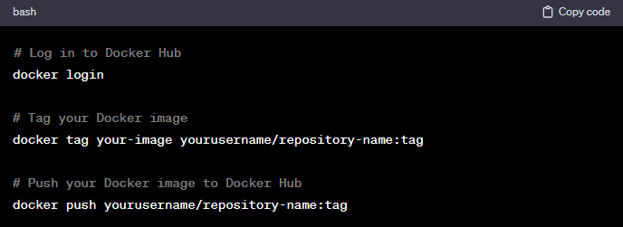
Docker Login
To login to docker

Slide 10
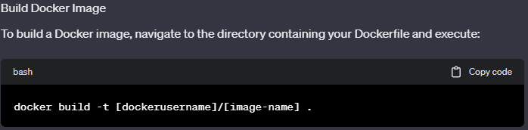
Docker build
To build images in Docker
docker: This is the name of the Docker command-line interface (CLI) tool.
build: This is the Docker command for building an image.
-t: This option is used to tag the image with a name.
[dockerusername]: This is the username of the Docker user that will own the image.
/: This is the path separator.
[image-name]: This is the name of the image that will be built.
.: This is a wildcard character that matches all files in the current directory.

Slide 11
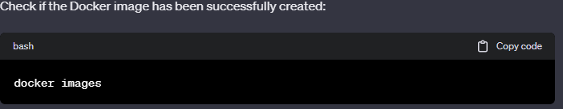
Docker build
To see whether the image is been created

Slide 12
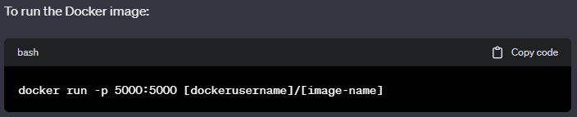
Docker Create
To run the created docker image
-p : The “-p” option is used to expose a port on the host machine to a port inside the container. In this case, we are mapping port 5000 on the host machine to port 5000 inside the container. This means that any traffic that is sent to port 5000 on the host machine will be forwarded to port 5000 inside the container

Slide 13
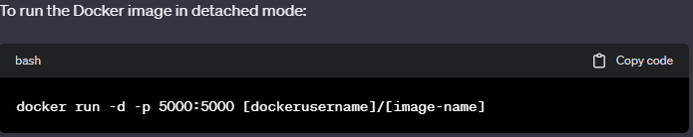
Docker detached
To run the created docker image in detached
-p The “-p” option is used to expose a port on the host machine to a port inside the container. In this case, we are mapping port 5000 on the host machine to port 5000 inside the container. This means that any traffic that is sent to port 5000 on the host machine will be forwarded to port 5000 inside the container.
The -d option is used to run the container in detached mode. This means that the container will run in the background and will not attach to the current terminal.

Slide 14
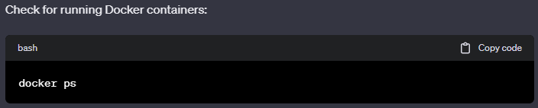
Docker run
To see the running docker image
The docker ps command is used to list all of the Docker containers that are currently running on your system. The output of the command includes the container ID, image name, container name, status, ports, and networks.

Slide 15
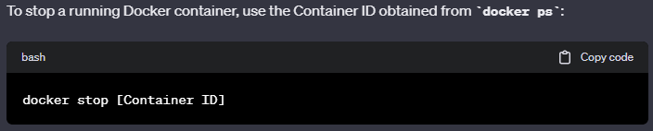
Docker stop
To stop the created docker image

Slide 16
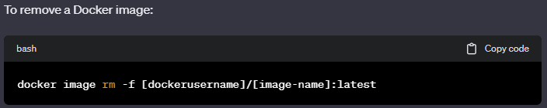
Docker remove
To remove the created docker image
docker: This is the name of the Docker command-line interface (CLI) tool.
image: This is the Docker command for managing Docker images.
rm: This is the subcommand for removing a Docker image.
-f: This is a flag that means to force the removal of the image, even if it is currently in use by a container.
[dockerusername]/[image-name]: This is the name of the image that you want to remove.
:latest: This is the tag of the image that you want to remove. Tags are labels that are used to identify different versions of an image. In this case, the :latest tag specifies that you want to remove the latest version of the image.

Slide 17
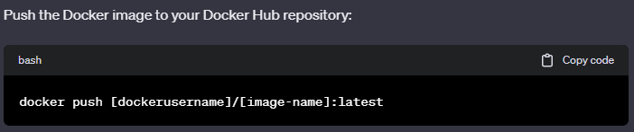
Docker push
To push the created docker image

Slide 18
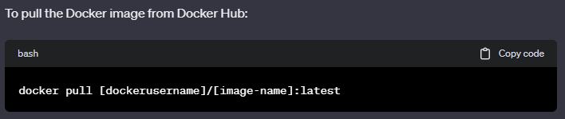
Docker pull
To pull the docker image

Slide 19
Docker Commands in spreadsheet view
https://docs.google.com/spreadsheets/d/1bTuK-ZhOHsL5yU-MIYwtRYeXCEwnle-kgYBXcm5KMyc/edit#gid=1643686534

Slide 20

Conclusion
Docker is a powerful platform for building, running, and managing containerized applications. It is a popular choice for developers and DevOps teams who want to build and deploy applications quickly and easily

